Slide 1
고급 프로그래밍
2018년 1학기
성병문
한세대학교 일반대학원

Slide 2
목차
Chap 1. 컴퓨터 언어/ C++ 프로그래밍 절차
Chap 2. C++ 프로그램 구성 요소 / Data Type / Literal
Chap 3. Stream / manipulator / File I/O
Chap 4. Selection
Chap 5. Loop
Chap 6. Function
Chap 7. Enumeration/Namesapce/String
Chap 8. Array
Chap 9. struct
Chap 10. Class
Chap 11. Inheritance
Chap 12. POINTERS, ABSTRACT CLASSES
Chap 13. OVERLOADING AND TEMPLATE

Slide 3
교과목 개요
과목명: 고급 프로그램
학점 및 시간 : 2학점(이론 1시간, 실습 1시간)
강의 개요
C++ 프로그래밍 언어의 역사 및 장단점
C++ 프로그래밍 언의의 기본 요소
C++ 프로그래밍 절차와 관련 툴
C++ 프로그래밍 고급 기법들
교재:
C++ Programming From Problem Analysis To Program Design 6th ed. / D.S MALIK / Cengage Learning / 2013

Slide 4
메모
GIT Repository
https://github.com/sunabove/lec_120_cpp

Slide 5
실습 환경
Visual Studio 2017
C++
GitHub Extension for Visual Studio
https://visualstudio.github.com/

Slide 6

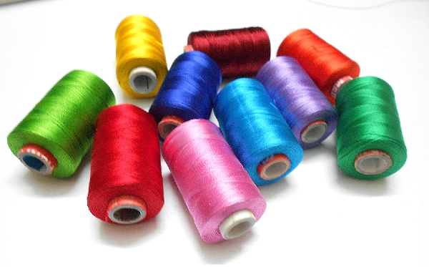
Concept
STREAM
THREAD

Slide 7
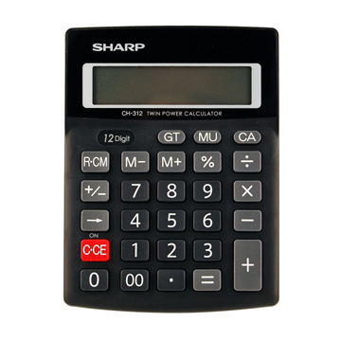
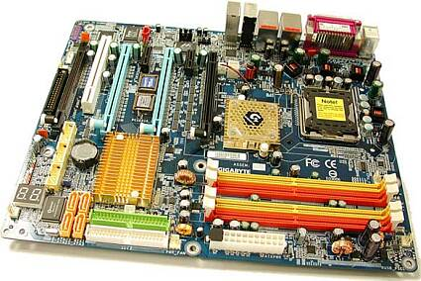
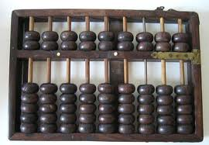
What is a computer?
A computer is a computing machinery.

Slide 8
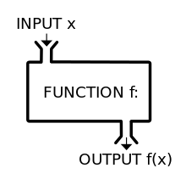
What is programming?
Input
Process
Output

Slide 9
What is learning a language?
Grammar
Words
Culture/Environment/History
Tool/Framework/Library

Slide 10
Programming Methodologies (p. 20)
Structured Programming
Dividing a problem into smaller sub-problems is called structured design.
Each sub-problem is then analyzed, and a solution is obtained to solve the sub-problem.
The solutions to all of the sub-problems are then combined to solve the overall problem.
The structured-design approach is also known as top-down design, bottom-up design, stepwise refinement, and modular programming.
Object-Oriented Programming
The first step in the problem-solving process is to identify the components called objects, which form the basis of the solution, and to determine how these objects interact with one another.

Slide 11
ANSI/ISO Standard C++ (p. 22)
The programming language C++ evolved from C and was designed by Bjarne Stroustrup at Bell Laboratories in the early 1980s.
In mid-1998, ANSI/ISO C++ language standards were approved.
In mid-2010, the second standard of C++ was voted on and approved. The main objective of this standard, referred to as C++0X, or tentatively as C++11, is to make the C++ code cleaner and more effective.

Slide 12
Ex 2-1 (p. 29)
//************************************************************** // Given the length and width of a rectangle, this C++ program // computes and outputs the perimeter and area of the rectangle. //************************************************************** #include <iostream> using namespace std;
int main() {
double length; double width; double area; double perimeter; cout << "Program to compute and output the perimeter and "
<< "area of a rectangle." << endl; length = 6.0; width = 4.0; perimeter = 2 * (length + width); area = length * width; cout << "Length = " << length << endl; cout << "Width = " << width << endl; cout << "Perimeter = " << perimeter << endl; cout << "Area = " << area << endl; return 0;
}

Slide 13
선언과 정의
Declaration
Definition
Assignment
int i ; // declaration
i = 0 ; // definition

Slide 14
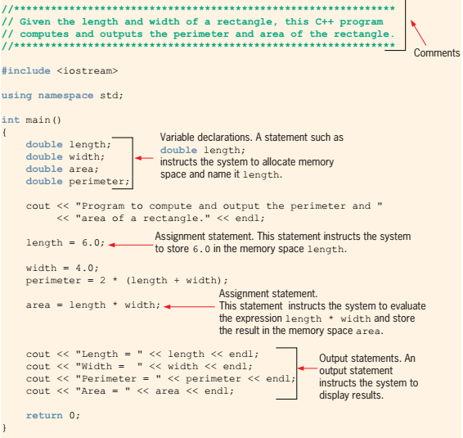
Ex 2-1 (p32)

Slide 15
_getch( )
출처: https://docs.microsoft.com/en-us/cpp/c-runtime-library/reference/getch-getwch
Gets a character from the console without echo.
Syntax
int _getch( void );
wint_t _getwch( void );
Return Value
Returns the character read. There is no error return.
Remarks
The _getch and _getwch functions read a single character from the console without echoing the character. None of these functions can be used to read CTRL+C. When reading a function key or an arrow key, each function must be called twice; the first call returns 0 or 0xE0, and the second call returns the actual key code.
Requirements
#include <conio.h>

Slide 16
The Basics of a C++ Program (p. 34)
A C++ program is a collection of one or more subprograms, called functions.
A function is a collection of statements.
Programming language:
A set of rules, symbols, and special words.

Slide 17
The Basics of a C++ Program
Comments
Special Symbols
Reserved Words
Identifier
Whitespaces

Slide 18
The Basics of a C++ Program (p. 34)
Comments
The program that you write should be clear not only to you, but also to the reader of your program.
Part of good programming is the inclusion of comments in the program.
Comments are for the reader, not for the compiler.
//************************************************************** // Given the length and width of a rectangle, this C++ program // computes and outputs the perimeter and area of the rectangle.
//**************************************************************
/* You can include comments that can occupy several lines. */

Slide 19
The Basics Of a C++ Program (p35)
Special Symbols
The smallest individual unit of a program written in any language is called a token.
C++’s tokens are divided into special symbols, word symbols, and identifiers.
Following are some of the special symbols:
+ - * /
. ; ? ,
<= != == >=

Slide 20
The Basics of a C++ Program (p36)
Reserved Words (Keywords)
Keyword symbols cannot be redefined within any program
They cannot be used for anything other than their intended use.

Slide 21
C++ Keywords

Slide 22
The Basics of a C++ Program (p. 36)
Identifiers
Identifiers are names of things that appear in programs, such as variables, constants, and functions.
A C++ identifier consists of letters, digits, and the underscore character ( _ ) and must begin with a letter or underscore.
C++ is case sensitive.

Slide 23
The Basics of a C++ Program (p37)
Whitespaces
Whitespaces include blanks, tabs, and newline characters.
Whitespaces are used to separate special symbols, reserved words, and identifiers.
Proper utilization of whitespaces in a program is important.
They can be used to make the program more readable.

Slide 24
C++ Types
Void Type
void
Primitive Type
Boolean Type
bool
Integral Type
short / char / int / long
Floating-point Type
float / double / long double
Character Type
char / wchar_t
User Defined Type
struct
union
class
Enumeration
상수를 열거한다.
enum
Pointer Type
Memory address of a variable

Slide 25
C++ Type Modifier
const
상수
static
전역 변수
unsigned
양수
signed
음수/양수
생략 가능
long
값의 범위 확대
volatile
캐시 사용하지 않음.
thread safe

Slide 26
Simple Data Types (p. 38)
Synonym
Simple Type / Primitive Type / Fundamental Type / Arithmetic Type
The simple type is the fundamental type which builds structured types.
Simple Types
Bool Type
true / false
Integral Types
Integer numbers
Floating-Point Types
Real numbers
Floating point(부동소수점 / 浮動小數點)
Character Types
char
wchar_t

Slide 27
Integral Types ½

Slide 28
Integral Types 2/2
The C++ Language Specification simply states that the size of a long must be at least the size of an int.
History
C started with char (8 bits) and int (16 bits).
Then one added short (16 bits) and long (32 bits), while int could be 16 or 32 bits depending on what was natural on the platform and the pressure of backward compatibility.
When 64 bits came, long long was added as a 64 bits type and there was some adjustments in the smaller types on 64 bits platforms.
Things stabilized with a 32 bits int, but long kept various definitions.
Some 64 bits platforms have a 64 bits long, while other (perhaps only Windows?) kept long to 32 bits, probably due to different pressure of backward compatibility.
Unix had a long history of assuming long as the same size as a pointer.
Windows had more remnant in its API of the time when int was 16 bits and thus long was the only 32 bits type.

Slide 29
Floating-point Types

Slide 30
Bool Literal
true
false

Slide 31
Integral Literal Example

Slide 32
Floating-point Literal Example

Slide 33
Character Literal Example

Slide 34
Escape Sequence (p. 78)

Slide 35
String Literal Example

Slide 36
Arithmetic Operators, Operator Precedence ( p. 43)
Arithmetic Operator
+ - * / %
정수 연산 결과는 정수이다.
실수 연산 결과는 실수이다.
정수/실수 연산 결과는 실수이다.
Operator Precedence
산술 연산 우선 순위를 따른다.
( )

Slide 37
Type Conversion (Casting) ( p. 51)
Implicit Type Casting(coercion)
묵시적 형변환
Explicity Type Casting
명시적 형변환
synonym
cast operator / type conversion / type casting
form
static_cast<dataTypeName>(expression)
(dataTypeName)(expression)

Slide 38
string type ( p. 53)
The string type is a user-defined one.
The string type is very powerful and more complex than simple data types.
ex:
#include <string>
string s = "Hello, World!" ;

Slide 39
Input Statement (p. 63)
표준 입력
syntax
cin >> variable >> variable ;
>> is called the stream extraction operator.

Slide 40
Ex 2-17 (p.64)
#include <iostream>
using namespace std;
int main() { int feet; int inches;
cout << "Enter two integers separated by one or more spaces: ";
cin >> feet >> inches;
cout << endl; cout << "Feet = " << feet << endl; cout << "Inches = " << inches << endl; return 0; }

Slide 41
Increment and Decrement Operator (p. 70)
Increment
Pre-increment
++ i ;
i += 1 ;
Post-increment
i ++ ;
Decrement
Pre-decrement
-- i ;
i -= 1 ;
Post-decrement
i -- ;

Slide 42
Processor Directive (p. 79)
Processor directives are processed by a preprocessor.
example
#include <headerFileName>
#include "headerFileName"

Slide 43
Namesapce (p. 80)
이름 공간
명시적 이름 공간
묵시적 이름 공간
Chapter 7.

Slide 44
Debugging (p. 85)
Understanding and Fixing Syntax Errors
Code to debug
Know how to make an error.
Process fail conditions at first.

Slide 45
CHAPTER 3
INPUT/OUTPUT

Slide 46
Ch3. Input/Output (p. 122)
A stream is a sequence of characters(=bytes) from the source to the destination.
Input stream:
A sequence of characters from an input device to the computer.
istream is ;
Output stream:
A sequence of characters from the computer to an output device.
ostream os ;
Syntax
#include <iostream>
cout << " … " ;
cint >> i ;

Slide 47
Using Predefiend Functions (p. 128)
수학 함수
#include <cmath>
pow( … ) , sqrt( … ) , etc

Slide 48
cin functions (p. 131)
cin.get(varChar)
The syntax of cin, together with the get function to read a character.
cin.get(varChar) ;
cin >> varChar ;
cin.ignore(intExp, chExp);
cin.ignore(100, 'A') ;
results in ignoring the first 100 characters or all characters until the character 'A' is found, whichever comes first.
Example 3-6

Slide 49
The putback and peek Funtions (p.134)
The stream function putback lets you put the last character extracted from the input stream by the get function back into the input stream.
isStreamVar.putback( ch ) ;
The peek function returns the next character from the input stream but does not remove the character from that stream.
ch = istreamVar.peek();
Example 3-6

Slide 50
The clear Function (p. 140)
When an input stream enters the fail state, the system ignores all further I/O using that stream.
You can use the stream function clear to restore the input stream to a working state.
Syntax
istreamVar.clear( );

Slide 51
Formatting Output (p.142)
cout << expression or manipulator << exp or mani … ;
Manipulator
setpreision( n ) : control the output precision of floating-point numbers.
cout << setprecision(2);
fixed : output floating-point numbers in a fixed decimal format.
cout << fixed ;
cout.unset( ios:: fixed ) ;
scientific
3.545e+001
showpoint : force the output to show the decimal point and trailing zeros
setw( n ) : outputs the value of the next expression in n columns.
setfill( ch ) : fill the unused columns with a character other than a space.
left , right : justify output
cout << left ;
cout.unset( ios:: left ) ;
Ex 3-10 , Ex 3-11, Ex 3-12, Ex 3-13

Slide 52
File IO Steps (p. 157)
File I/O is a four-step process:
Declare file stream variables.
#include <fstream>
ifstream is ;
ofstram os ;
Associate the file stream variables with the input/output sources.
is.open( "inFileName" ) ;
os.open( "outFileName" ) ;
Use the file stream variables with >>, <<, or other input/output functions.
is >> ch ;
os << ch ;
Close the files.
is.close( );
os.close( );
Ex : Complete Program Listing (p. 168)

Slide 53
CHAPTER 4
CONTROL STRUCTURES I
(SELECTION)

Slide 54
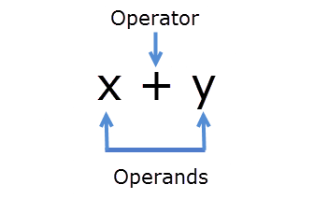
Operator and Operand

Slide 55
Operator Classification
Operator |  | Relational | Boolean
Unary | + , - |  | !
Binary |  | < , > , == , etc | && , ||
Ternary | ?

Slide 56
Relational Operators (p. 186)
Operator | Description
== | equal to
!= | not equal to
< | less than
<= | less than or equal to
> | greater than
>= | greater than or equal to
Example | if( 0 ) { // may not be executed } if( -1 ) { // may be executed } if( 8 < '5' ) { // may be executed }

Slide 57
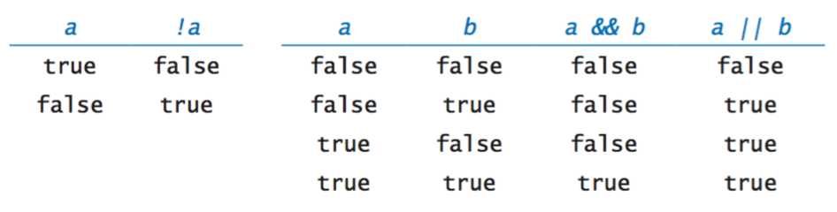
Boolean Operators (p. 190)
Operator | Description
! | not
&& | and
|| | or

Slide 58
String Relational Operator (p. 188)
The relational operators can be applied to variables of type(class) string.
Strings are compared character by character, starting with the first character and using the ASCII collating sequence.
The character-by-character comparison continues until either a mismatch is found or the last characters have been compared and are equal.
Ex 4-2

Slide 59
Selection Statements
if( exp ) { }
? :
switch( expr )

Slide 60
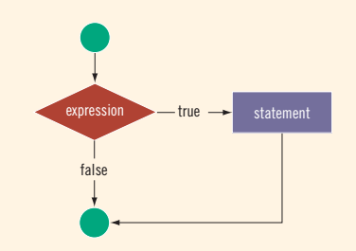
One Way Selection (p. 197)
if( expression ) {
statement
} else if( expression ) {
statement
} else {
statement
}

Slide 61
Conditional Operator ( ? : ) (p. 219)
exp1 ? exp2 : exp3 ;
if( a >= b ) {
max = a ;
} else {
max = b ;
}
max = ( a > = b ) ? a : b ;

Slide 62
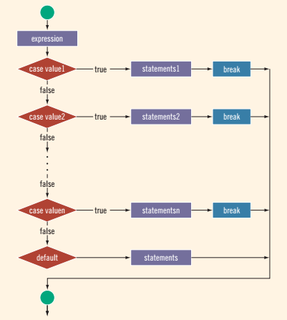
switch Structures (p. 223)
switch( exp ) {
case v1 :
statement1
case v2 :
statement2
.
.
.
default:
statement
}
Ex: 4-22

Slide 63
assert function (p. 231)
C++ includes a predefined function, assert, that is useful in stopping program execution when certain elusive errors occur.
Syntax
#include <cassert>
assert( exp ) ;
If expression evaluates to true, the next statement executes. If expression evaluates to false, the program terminates and indicates where in the program the error occurred.
Ex
assert( 1/0 ) ;
You can disable assert statements by using the following preprocessor directive:
#define NDEBUG
#include <cassert>

Slide 64
CHAPTER 5
CONTROL STRUCTURES II
(REPITITION)

Slide 65
Repitition Statements
for( ; ; )
while( exp )
do { } while( exp )

Slide 66
Repitition Synonyms
Repitition
= Loop
= Iteration
= Iterator
~= Cursor

Slide 67
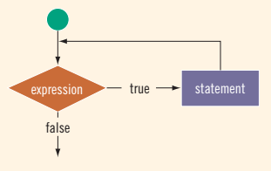
while Loop (p. 261)
while( exp ) {
statement
}
Ex: 5-1
Ex: 5-6 Number Guessing

Slide 68
EOF-Controlled while loop (p. 277)
EOF : End-Of-File
Ex:
ifstream is ;
is.get(ch);
while( ! is.eof() )
{
cout << ch;
is.get(ch);
}

Slide 69
실습: Fibonacci Number (p. 283)
Fibonacci Sequence
1, 1, 2, 3, 5, 8, 13, 21, 34, ....
an = an-1 + an-2
Find nth Fibonacci Number
정수형 수치연산을 이용하여 피보나치수의 최대값 구하기
실수형 해석해를 이용하여 피보나치수의 최대값 구하기

Slide 70
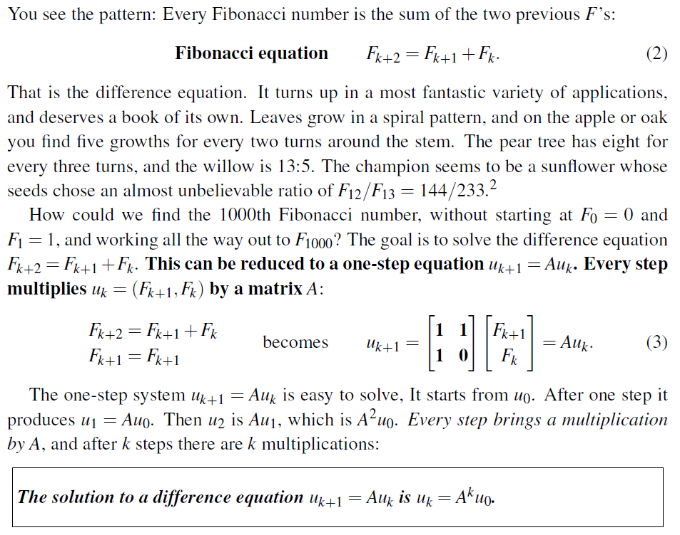
Fibonacci number

Slide 71
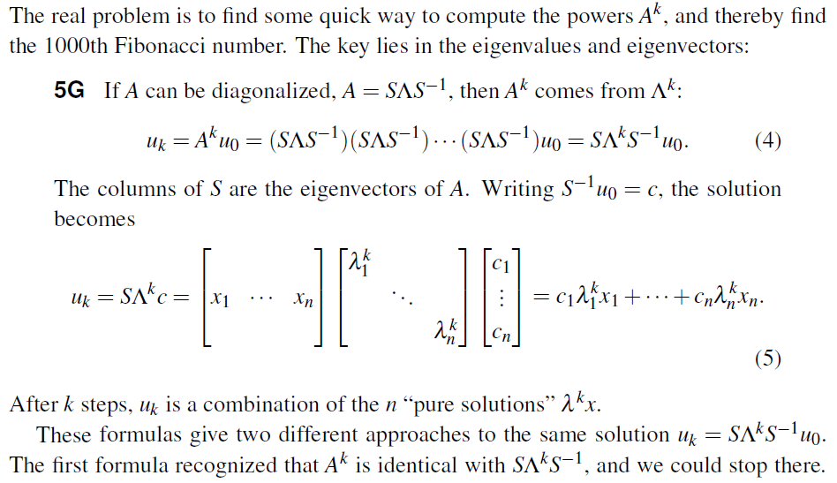
Fibonacci number

Slide 72
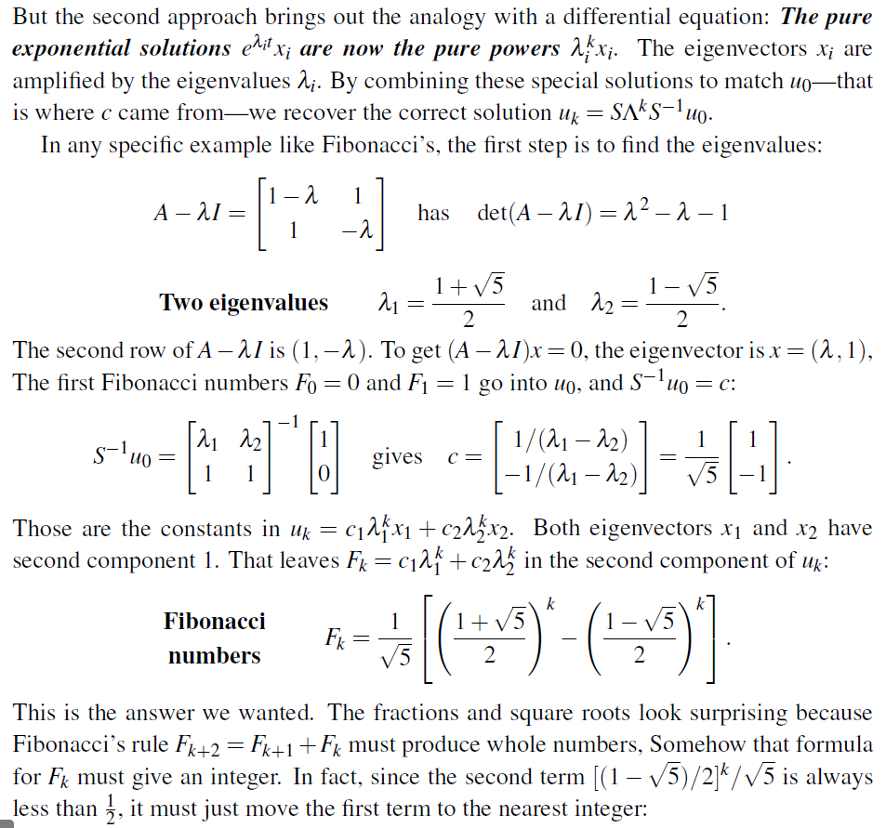
Fibonacci number

Slide 73
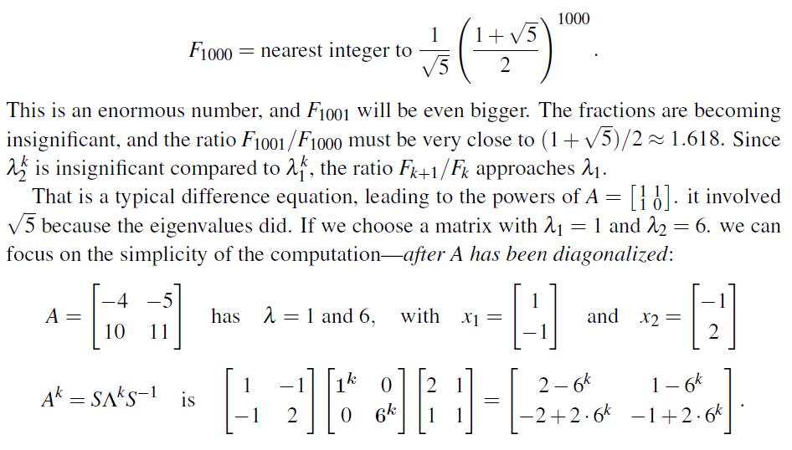
Fibonacci number

Slide 74
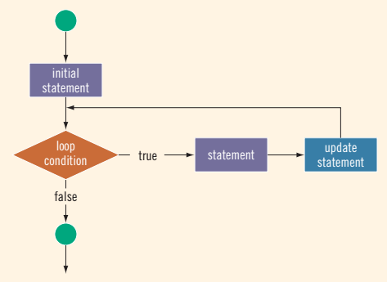
for Loop (p. 287)
for(stmt1 ; stmt1 ; stmtr ) {
stmt3 ;
}
Ex:5-17 Sum

Slide 75
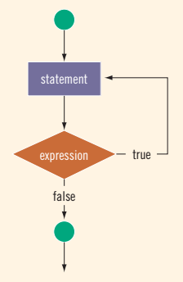
do .. while Loop (p. 298)
do {
stmt ;
} while( expr )
Ex:5-20

Slide 76
beak and continue (p. 303)
The break statement is typically used for two purposes:
To exit early from a loop.
To skip the remainder of the switch structure.
The continue statement skips the remaining statements in the loop and proceeds with the next iteration of the loop.

Slide 77
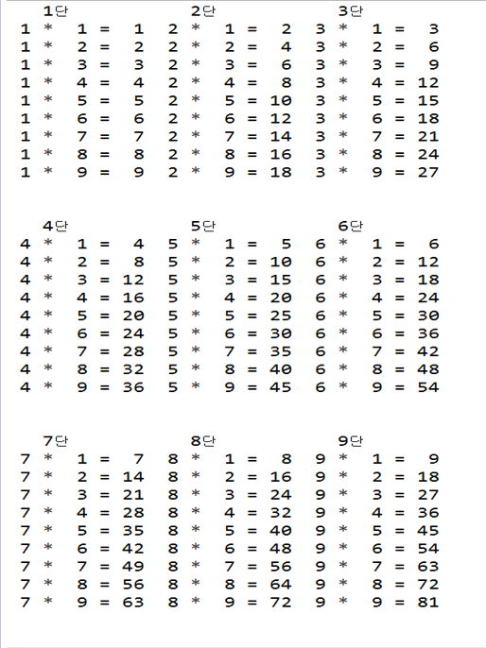
Ex 5-22 (p. 306)
Multiplication table

Slide 78
CHAPTER 6
Use-Defined Functions

Slide 79
Predefined Functions(p. 336)
Function | Header File | Purpose | Parameter Type | Return Type
floor(x) | <cmath> | Returns the largest whole number that is not greater than x:floor(45.67) = 45.00 | double | double
islower(x) | <cctype> | Returns 1 (true) if x is a lowercase letter; otherwise, it returns 0 (false); islower('h') is 1 (true) | int | int
isupper(x) | <cctype> | Returns 1 (true) if x is an uppercase letter; otherwise, it returns 0 (false); isupper('K') is 1 (true) | int | int
pow(x, y) | <cmath> | Returns xy; if x is negative, y must be a whole number: pow(0.16, 0.5) = 0.4 | double | double
sqrt(x) | <cmath> | Returns the nonnegative square root of x; x must be nonnegative: sqrt(4.0) = 2.0 | double | double
tolower(x) | <cctype> | Returns the lowercase value of x if x is uppercase; otherwise, it returns x | int | int
toupper(x) | <cctype> | Returns the uppercase value of x if x is lowercase; otherwise, it returns x | int | int

Slide 80
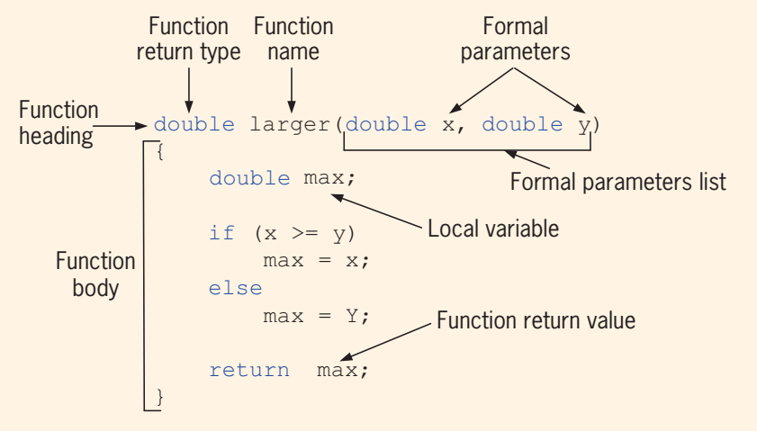
User-Defined Functions (p. 343)
Define : Proto Type
functionType functionName(parameter list) ;
Declaration :
functionType functionName(parameter list) { statements }
Ex: 6-10 :
삼각형 출력

Slide 81
Reference Variable (p. 371)
A reference parameter receives the address (memory location) of the actual parameter.
Reference parameters are useful in three situations:
When the value of the actual parameter needs to be changed
When you want to return more than one value from a function
When passing the address would save memory space and time relative to copying a large amount of data

Slide 82
Static and Automatic Variable (p. 395)
Automatic variable:
is allocated at block entry and deallocated at block exit.
Static Variable:
remains allocated on a memory as long as the program executes.
Syntax:
static Type identifier;

Slide 83
Function Overloading (p. 399)
Function overloading
Functions can have the same name.
The parameter type is different.
Ex.
void f(int x)
void f(int x, double y)
void f(double y, int x)
int f(char ch, int x, double y)
int f(char ch, int x, string name)

Slide 84
Ex: Couse Average (p. 417)
Input Data
CSC 90 75 90 75 80 89 100 60 80 70 80 -999
ENG 80 80 70 68 70 78 80 90 90 76 -999
HIS 100 80 80 70 90 76 88 90 90 75 90 85 80 -999
Output
Course Course Average
ID 0 10 20 30 40 50 60 70 80 90 100
|....|....|....|....|....|....|....|....|....|....|
CSC *****************************************
ENG ########################################
HIS *****************************************

Slide 85
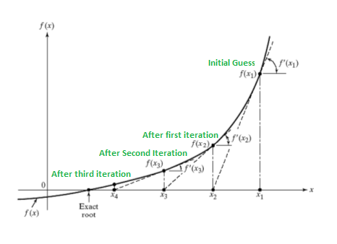
Newton Raphson Method 1/3
The Newton-Raphson Method, properly used, usually homes in on a root with devastating efficiency.
Algorithm
1. Let r be a root of the equation f(x) = 0.
2. We start with an estimate x0 of r.
3. From x0, we produce a estimate x1.
4. From x1, we produce a new estimate x2.
5. From x2, we produce a new estimate x3.
6. We go on until we are `clos eenough' to r.

Slide 86
Newton Raphson Method 2/3
The Newton Raphson method is for solving equations.
The tangent line of f(x) at the point (x₀, f(x₀))
y = f'(x₀)*(x − x₀) + f(x₀)
The tangent line intersects the x-axis
x₁ = x₀ − f(x₀)/f'(x₀)
and, more generally,
x_{n+1} = x_{n+1} − f(x_{n})/f'(x_{n})

Slide 87
Newton Raphson Method 3/3
#include "stdafx.h"
#include <stdio.h>
typedef double number;
const number epsilon = 0.000000001;
const number e = epsilon;
number f(number x) {
return x*x - 4;
}
number derivative(number x) {
number der = (f(x + e) - f(x)) / e;
return der;
}
int main() {
number x = 6.0;
number y = 0;
int index = 0;
do {
y = f(x);
printf("\nf(%.20f)=%.20f", x, y);
x = x - (y / derivative(x));
} while( y > epsilon || -y > epsilon );
return 0;
}

Slide 88
CHAPTER 7
User-Defined Type
Name Space
string

Slide 89
Enumeration (p. 452)
The statement:
enum Grade {A, B, C, D, F};
defines a new data type called Grade .
The values belonging to this data type are
A, B, C, D, E, F.
No arithmetic operations are allowed.
Grade g = A + B ; // illegal

Slide 90
Declaring Variables When Defining the Enumeration Type
enum Grade {A, B, C, D, F} g ;

Slide 91
Anonymous Data Type (p. 461)
A variable declaration with no type name is called an anonymous type.
The following statement creates an anonymous type:
enum {BASKETBALL, FOOTBALL, BASEBALL } sports;

Slide 92
typedef Statement (p. 461)
Synonyms or aliases to a defined data type
typedef aType bType ;

Slide 93
Namespace (p. 471)
In July 1998, ANSI/ISO Standard C++ was officially approved.
Most recent compilers are also compatible with ANSI/ISO Standard C++.
The two standards are virtually the same.
The ANSI/ISO Standard C++ language has some features that are not available in Standard C++.
The C++ syntax applies to both standards.
Syntax
namespace myNameSapce {
statements ;
}
Accessing a namespace member is:
myNameSapce::identifier
using namespace myNameSapce;
Ex: 7-12

Slide 94
string Type (p. 476)
Recall that prior to the ANSI/ISO C++ language standard, the Standard C++ library did not provide a string data type.
Compiler supplied their own programmer-defined string type
The syntax and semantics of string operations varied from vendor to vendor.
The data type string is a programmer-defined type and is not part of the C++ language;
the C++ standard library supplies it.
Syntax
#include <string>
string name = "john"

Slide 95
Additional string Operations (p. 480)
string::size_type
An unsigned integer (data) type
string::npos
The maximum value of the (data) type string::size_type,
a number such as 4294967295 on many machines
String functions
Table 7-1 (p.480)
Ex: 7-14, 15, 16, 18 (p. 482)

Slide 96
CHAPTER 8
ARRAY AND STRING

Slide 97
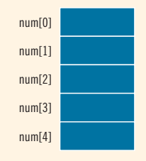
Array (p. 507)
An array is a collection of a fixed number of components all of the same data type.
DataType arrayName[intExp];
int num[5] ;

Slide 98
Array Initialization During Declaration( p. 516)
double sales[4]={12.25, 32.50, 16.90 };
double sales[] ={12.25, 32.50, 16.90 };
double sales[4]={12.25, 32.50 };

Slide 99
Some Restrictions on Array Processing (p. 517)
int myList[5] = {0, 4, 8, 12, 16};
int yourList[5];
yourList = myList; //illegal
for (int i = 0; i < 5; i ++) { yourList[i] = myList[i];
}

Slide 100
Arrays as Parameters to Functions (p. 518)
In C++, arrays are passed by reference only.
void funcArray (int a[], double b[]) { ... }
Functions cannot return an array type.

Slide 101
sizeof
int a ; // 4
int b [10]; // 4*10
int * c ; // 8

Slide 102
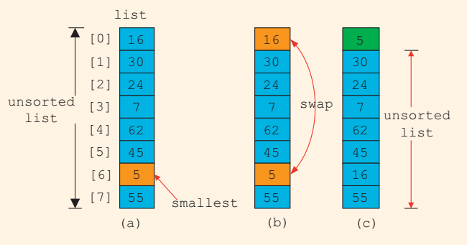
Ex: Selecton Sort (p. 530)
Selection Sort algorithm
finds the location of the smallest element in the unsorted portion of the list
and moves it to the top of the unsorted portion of the list.
The first time, it locate the smallest item in the entire list.
The second time,
it locate the smallest item in the list starting from the second element in the list.
and so on.
EX: 8-9 (p. 534)

Slide 103
c-Strings (character array)
#include <cstring>
char name[16] = {'J','o','h','n','\0'} ;
char name[16] = "John" ;
char name[] = "John" ;
char * name = "John" ;
strcpy(s1, s2)
strcmp(s1, s2)
strlen(s)

Slide 104
CHAPTER 9
STRUCTS

Slide 105
Struct (p. 592)
An array is a homogeneous data structure.
A struct is a heterogeneous data structure.
A struct is a C-like struct.
class = struct + function

Slide 106
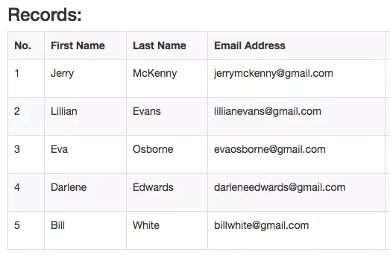
Record = struct (p. 592)
struct
A collection of a fixed number of components.
The components are accessed by name.
The components may be of different types.
Syntax
struct structName { dataType1 identifier1; dataType2 identifier2; ... dataTypen identifiern; };

Slide 107
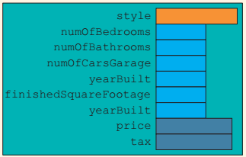
struct houseType (p. 593)
struct House { string style; int numOfBedrooms; int numOfBathrooms; int numOfCarsGarage; int yearBuilt; int finishedSquareFootage; double price; double tax; };
House house ;
string style = house.style ;

Slide 108
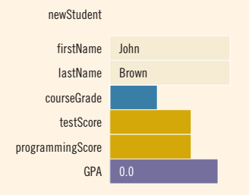
Accessing struct members (p. 594)
The dot (.) is the member access operator.
struct StudentType { string firstName; string lastName; char courseGrade; int testScore; int programmingScore; double GPA; };
StudentType newStudent; newStudent.GPA = 0.0; newStudent.firstName = "John"; newStudent.lastName = "Brown";

Slide 109
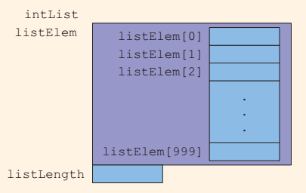
Arrays in structs (p. 600)
const int ARRAY_SIZE = 1000; struct ListType
{
int listElem[ ARRAY_SIZE ];
int listLength;
}
ListType intList ;

Slide 110
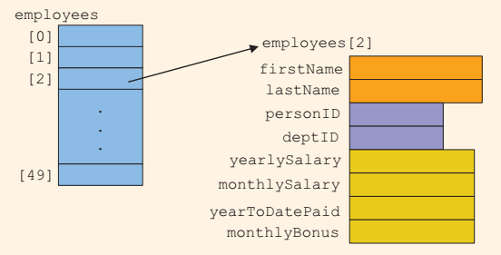
struct array (p. 602)
struct Employee { string firstName; string lastName; int personID; string deptID; double yearlySalary; double monthlySalary; double yearToDatePaid; double monthlyBonus; };
Employee employees[50];

Slide 111
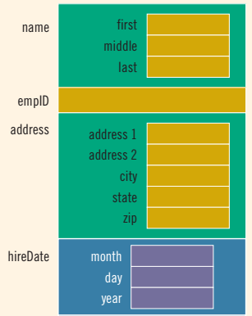
strucs in a struct (p. 604)
struct Name { string first; string middle; string last; };
struct Address { string address; string city; string state; string zip; };
struct Date { int month; int day; int year; };
struct Employee { Name name; string empID; Address address; Date hireDate; };

Slide 112
Ex: Emplyee struct
Make an employee variable.
Assing the employee data.
Print the employee data.

Slide 113
CHAPTER 10
Class and Data Abstraction

Slide 114

객체
What is an object?

Slide 115

Four Pillars of Object Oriented Programming
Abstraction (추상화)
Hierarchy (계층 구조)
Encapsulation (은닉)
Polymorphism (다형성)

Slide 116

Abstraction (추상화)
공통된 것을 추출한다.
모델링 한다.

Slide 117
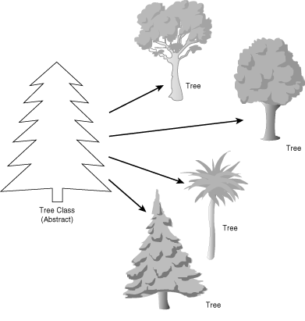
A class and objects
클래스는 객체들을 추상화한다.
속성: attribute = data
기능: method = function

Slide 118
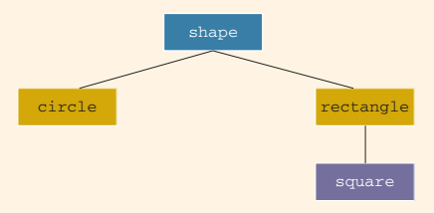
Hierarchy(계층 구조/상속)
A child class inherits a parent class.
class Shape { }
class Rectangle : Shape { }

Slide 119


Encapsulation(은닉)
A class protects a private attribute.
Access Modifier

Slide 120
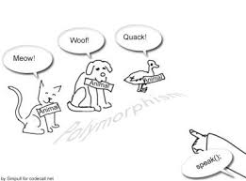
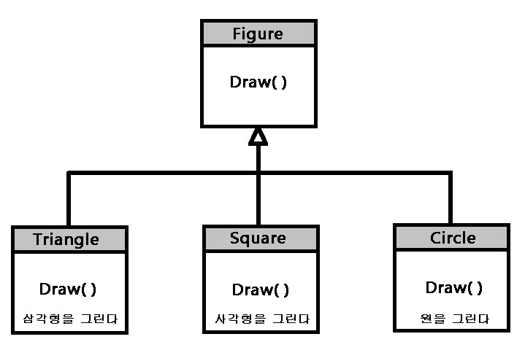
Polymorphism(다형성)
기능의 이름이 같아도 실제 동작들은 다르다.
virtual function

Slide 121
Class (p. 630)
A class combines data and functions.
In OOD
The first step is to identify the objects.
An object combines data and the operations in a single unit.
The components of a class are called the members of the class.

Slide 122
Class (p. 630)
Syntax
class MyClass {
Type member ;
....
}
Class member is a variable or a function.
Access Modifier
The members are classified into categories: private, public, and protected.
By default, a member are private.
A private member is not accessible outside of the class.
A public member is accessible outside of the class.
A protected member is accessible from a child classs.

Slide 123
class Clock (p. 632)
class Clock { public: void setTime(int, int, int); void getTime(int&, int&, int&) const; private: int hr; int min; int sec; };
The word const functions cannot modify the member variables of a variable of type clockType.

Slide 124
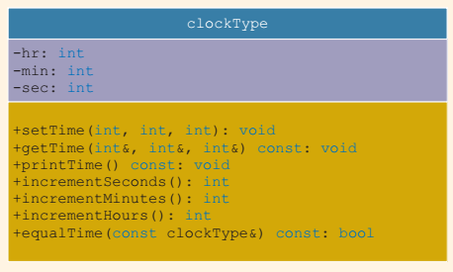
Unified Modeling Language Class Diagrams (p. 634)
A class can be described using UML notation.
The top box contains the name of the class.
The middle box contains the member variables and data types.
The last box contains the member functions.
A + (plus) sign indicates that this is a public member.
A - (minus) sign indicates that this is a private member.
The symbol # indicates that this is a protected member.

Slide 125
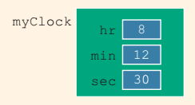
Object Declaration (p. 634)
Clock myClock;

Slide 126
Accessing Class Members (p. 635)
Syntax
objectName.memberVaraible
objectName.memberFunction( ... )

Slide 127
Ex: class Clock (p. 644)
Ex 10-2

Slide 128
Constructor (p. 649)
Constructor
The name of a constructor is the same as the name of the class.
A constructor, even though it is a function, has no type.
it is neither a value-returning function nor a void function.
A class can have more than one constructor.
All constructors of a class have the same name.
If a class has more than one constructor,
the constructors must have different formal parameter lists.
Constructors execute automatically when a class object enters its scope.
If a class has no constructor, C++ automatically provides the default constructor.

Slide 129
Constructor II (p. 650)
Invoking a Constructor
Aclass object is declared, a constructor is automatically executed.
Invoking the Default Constructor
Clock clock ;
Clock clock() ; // illegal
Invoking a Constructor with Parameters
Clock clock( 12, 6 , 30 ) ;

Slide 130
Destructor (p. 657)
A destructor is a function.
A destructor is called when the object life is finished.
A destructor does not have a type.
A class can have only one destructor.
A destructor has no parameters.
The name of a destructor is the tilde character (~), followed by the name of the class.
For example, the name of the destructor for the class Clock is:
~Clock() ;

Slide 131
Data Abstraction, Classes (p. 658)
Separating the design details (that is, how the car’s engine works) from its use is called abstraction.
In other words, abstraction focuses on what the engine does and not on how it works.
Thus, abstraction is the process of separating the logical properties from the implementation details.

Slide 132
Information Hiding (p. 661)
Encapsulation
Access modifier

Slide 133
Static members of a class (p. 673)
Static member
A static membrer is declared using the keyword static.
A static member can be accessed using the class name.

Slide 134
CHAPTER 11
Inheritance and Composition

Slide 135
Inheritance and Composition( p. 710)
Inheritance
‘‘is-a’’ relationship
Ex: A Rectangle is a Shape.
Composition (aggregation)
(‘‘has-a’’ relationship)
Ex: Rectangle has a width and a height.
Code
class Shape { };
class Rectangle : public Shape {
double width ;
double height ;
};

Slide 136
Inheritance (p. 710)
Inheritance create new class from an existing class.
An inherited class
derived class
child class
The existing class
base class
parent class
The derived class inherit the properties of the base class.

Slide 137
Inheritance 2/2 (p. 712)
class Circle: public Shape { ... };
class Circle: private Shape { ... };
This is a private inheritance.
The public members of shape become private members of the class circle.
Any object of type circle cannot directly access these members.

Slide 138
Overriding (p. 713)
Redefining bember functions of the Base Class
Polymorphism

Slide 139
Constructor of Derived and Base Class (p. 720)
When a derived class object is declared, it execute one of the constructors of the base class.
The execution of a derived class’s constructor must trigger the execution of one of the base class’s constructors.
Ex:
Square::Square() : Rectangle()
{
//
}
Square::Square(int width, int height):Rectangle(width, height)
{
//
}

Slide 140
Destructors in a Derived Class (p. 729)
When a derived class object goes out of scope, it automatically invokes its destructor.
When the destructor of the derived class executes, it automatically invokes the destructor of the base class.
So when writing the definition of the destructor of the derived class, an explict call to the destructor of the base class is not needed.
When the destructor of the derived class executes first, it executes its own code and then calls the destructor of the base class.

Slide 141
Protected Member (p. 733)
A derived class access the protected members of the base class.

Slide 142
Inheritance access modifier (p. 733)
public inheritance
The public members of A are public members of B.
The protected members of A are protected members of B.
The private members of A are hidden in B.
protected inheritance
The public members of A are protected members of B.
The protected members of A are protected members of B.
The private members of A are hidden in B.
private inheritance
The public members of A are private members of B.
The protected members of A are private members of B.
The private members of A are hidden in B.
class B: {public/protected/private} A { };

Slide 143
CHAPTER 12
POINTERS, CLASSES, VIRTUAL FUNCTIONS,
AND ABSTRACT CLASSES

Slide 144
Pointer Data Type and Pointer Variables (p. 782)
The value of a pointer variable is an memory address.
A pointer variable by using the asterisk symbol (*) between the data type and the variable name.
Ex
Type type;
Type * pointer = & type ;
pointer->member ;
(*pointer).member ;

Slide 145
Dereferencing Operator (p. 784)
int x = 25;
int *p;
p = &x;
cout << *p << endl;
*p = 55;

Slide 146
Initializing Pointer Variable (p. 792)
Pointer variables are initialized using the constant value 0, called the null pointer.
The following two statements are equivalent: p = NULL; p = 0;

Slide 147
Operator new (p. 792)
The operator new
allocate a single variable.
allocate an array of variables.
Syntax
new Type ;
new Type[ len ];
The operator new
allocates of the designated type.
returns a pointer to it.
The allocated memory is uninitialized.
Ex
int * p = 0;
p = new int ;
p = new int [16];

Slide 148
Operator delete (p. 794)
When a dynamic variable is no longer needed, it can deallocated.
The operator delete is used to destroy dynamic variables.
Syntax
delete variable ;
delete [] variables ;

Slide 149
Operations on Pointer Variables (p. 798)
The pointer operations
assignment opration
relational operation
arithmetic operations
The integer pointer p increased by 4 bytes.
int * i;
i ++;
The double pointer d increased by 4 bytes.
int * d;
d ++;

Slide 150
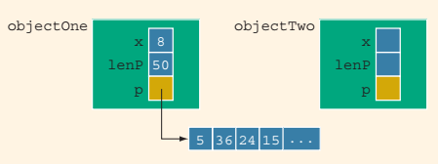
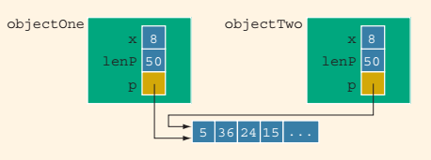
Class assignment Operator (p. 811)
The limitations of the built-in assignment operators for classes with pointer member variables.
To avoid this shallow copying of data for classes with a pointer member variable,
C++ extends the definition of the assignment operator.
This process is called overloading the assignment operator.
objectTwo = objectOne;

Slide 151
Copy Constructor (p. 812)
When declaring a class object, you can initialize it by using the value of an existing object of the same type.
The object two is initialized by using the value of object one.
ClassName two( one );
ClassName two = one ;
The general syntax
ClassName(const ClassName & other);
The formal parameter of the copy constructor is a constant reference parameter.

Slide 152
Virtual Function (p. 819)
A virtual function is a member function that you expect to be redefined in derived classes.
When you refer to a derived class object using a pointer or a reference to the base class, you can call a virtual function for that object and execute the derived class's version of the function.

Slide 153
Virtual Destructors (p. 826)
One thing recommended for classes with pointer member variables is that these classes should have the destructor.
If the object creates dynamic memory space, the destructor can be designed to deallocate that memory space.
If a base class contains virtual functions, make the destructor of the base class virtual.

Slide 154
Pure Virtual Function (p. 826)
A virtual funtion
A virtual function makes its class a polymorphic base class.
Derived classes can override virtual functions.
A pure virtual function
A pure virtual function implicitly makes the class it is defined for abstract.
Abstract classes cannot be instantiated.
Derived classes need to override/implement all inherited pure virtual functions.
A pure virtual function is a virtual function whose declaration ends in = 0:

Slide 155
Virtual Function (p. 827)
class Shape { virtual void draw(); virtual void move(double x, double y); };
class Shape { virtual void draw() = 0; virtual void move(double x, double y) = 0; };

Slide 156
Address of Operator (p. 835)
The address of operator, &, store the address of a variable into a pointer variable.
The address of operator is also used to create aliases to an object.
Both x and y refer to the same memory location.
int x;
int &y = x;

Slide 157
CHAPTER 13
OVERLOADING AND TEMPLATE

Slide 158
Operator Overloading (p. 855)
C++ allows the user to overload most of the operators.
It does not allow the user to create new operators.
Most of the existing operators can be overloaded to manipulate class objects.
The syntax
returnType operator operatorSymbol(formal parameter list)
Sample
Overloading the Stream Insertion (<<) Operators (p. 873)
Overloading the Assignment Operator (=) (p. 878)

Slide 159
Operator Overloading Restrictions (p. 856)
You cannot change the precedence of an operator.
The associativity cannot be changed.
The associativity of the arithmetic operator addition is from left to right, and it cannot be changed.
Default parameters cannot be used with an overloaded operator.
You cannot change the number of parameters an operator takes.
You cannot create new operators. Only existing operators can be overloaded.
The operators that cannot be overloaded are:
. .* :: ?: sizeof
The meaning of how an operator works with built-in types, such as int, remains the same.
Operators can be overloaded either for objects of the user-defined types, or for a combination of objects of the user-defined type and objects of the built-in type.

Slide 160
Pointer this (p. 857)
Every object of aclass maintains a pointer to itself, and the name of this pointer is this.

Slide 161
Friend Functions (p. 861)
A friend function of a class is a nonmember function of the class.
It has access to all of the members (public or non-public) of the class.
To make a function be a friend to a class.
The word friend appears only in the function prototype in the class definition, not in the definition of the friend function.

Slide 162
Template (p. 916)
Template is Type Parameter.
Syntax
template <class Type> declaration;
Ex 13-8
template <class Type> Type larger(Type x, Type y);

Slide 163
CHAPTER 14
Excpetion Handling

Slide 164
Exception (p. 944)
An exception is an occurrence of an undesirable situation that can be detected during program execution.
For example, division by zero is an exception.
Similarly, trying to open an input file that does not exist is an exception, as is an array index that goes out of bounds

Slide 165
try/catch block (p. 948)
The statements that may generate an exception are placed in a try block.
The try block also contains statements that should not be executed if an exception occurs.
The try block is followed by one or more catch blocks.
A catch block specifies the type of exception it can catch and contains an exception handler
Ex : 14-5, 14-8
try { //statements } catch (dataType1 identifier) { //exception-handling code } catch (...) { //exception-handling code }

Slide 166
Creating Your Own Exception Classes (p. 959)
C++ enables programmers to create their own exception classes to handle both the exceptions not covered by C++’s exception classes and their own exceptions.
Ex : 14-10, 14-11

Slide 167
Rethrowing and Throwing an Exception (p. 968)
The mechanism of rethrowing or throwing an exception is quite useful in cases in which a catch block catches the exception but cannot handle the exception, or if the catch block decides that the exception should be handled by the calling block or environment.
To rethrow or throw an exception, we use the throw statement.
Ex : 14-15, 14-16

Slide 168
CHAPTER 15
Recursion

Slide 169
Recursive Definition (p. 986)
The process of solving a problem by reducing it to smaller versions of itself is called recursion.
Recursion is a very powerful way to solve certain problems for which the solution would otherwise be very complicated.
Ex: 15-2

Slide 170
CHAPTER 17
Linked List

Slide 171
Windows Programming
--

Slide 172
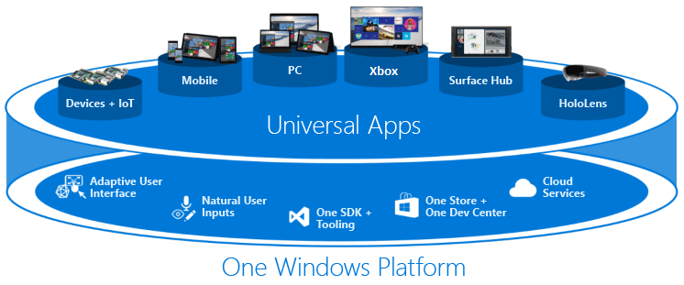
Windows Programing
Windows API Programming
MFC Progamming
Windows Form Programming
Universal Windows Programming

Slide 173
Window API Programming
Windows API tutorial
http://zetcode.com/gui/winapi/
Learn to Program for Windows in C++
https://msdn.microsoft.com/en-us/library/windows/desktop/ff381399(v=vs.85).aspx
Your First Windows Program
https://msdn.microsoft.com/en-us/library/windows/desktop/ff381409(v=vs.85).aspx
Windows Graphics
https://msdn.microsoft.com/en-us/library/windows/desktop/ff684175(v=vs.85).aspx
https://github.com/ujentus/D2DSample

Slide 174
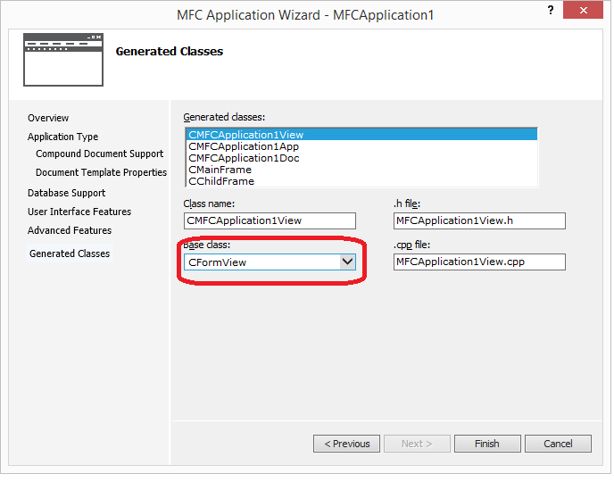
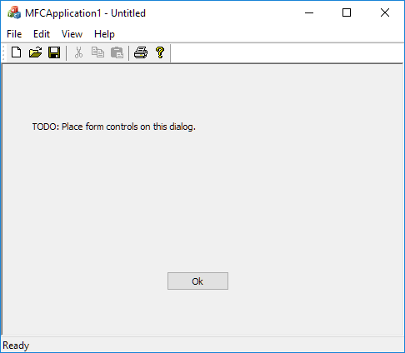
MFC Application
https://msdn.microsoft.com/en-us/library/9es9d1k4.aspx

Slide 175
Windows Form Application
Getting Started with Windows Forms
http://msdn.microsoft.com/en-us/library/ms229601.aspx
Creating a project
https://stackoverflow.com/questions/32404247/cant-find-windows-forms-application-for-c

Slide 176
Creating a windows form project
Create an empty C++ CLR project and add a Windows Forms to it.
Press Ctrl-Shift-A and create a Windows Form (under UI).
Inside the CPP file that is created, paste this code, replacing anything in square brackets except [STAThread] with the appropriate names:
#include "[FORM NAME].h"
using namespace System;
using namespace System::Windows::Forms;
[STAThread]//leave this as is
void main(array<String^>^ args) {
Application::EnableVisualStyles();
Application::SetCompatibleTextRenderingDefault(false);
Application::Run(gcnew [PROJECT NAME]::[FORM NAME]);
}
Configuration Properties > Linker > Advanced, change Entry Point to "main" (without quotation marks).
Configuration Properties > Linker > System, change SubSystem to "Windows (/SUBSYSTEM:WINDOWS)" (without quotation marks).

Slide 177
Windows Form Project
opencv 빌드
opencv 소스 다운로드
https://opencv.org/releases.html
2.4 버전 소스 zip 파일 다운로드
opencv library build
cmake 설치
cmake-gui 실행
Configure
Generatre
Open project
Visual Studio Project 빌드
Windows Form project 빌드
VisionWinFormApp 솔루션 Open
opencv include directories 설정
opencv library diectores 설정
opencv lib 설정

Slide 178
OpenCv
https://opencv.org
OpenCV (Open Source Computer Vision Library) is released under a BSD license and hence it’s free for both academic and commercial use.
It has C++, Python and Java interfaces and supports Windows, Linux, Mac OS, iOS and Android. OpenCV was designed for computational efficiency and with a strong focus on real-time applications.
Written in optimized C/C++, the library can take advantage of multi-core processing.
Enabled with OpenCL, it can take advantage of the hardware acceleration of the underlying heterogeneous compute platform.
Usage ranges from interactive art, to mines inspection, stitching maps on the web or through advanced robotics.

Slide 179

Cmake
https://cmake.org/
CMake is an open-source, cross-platform family of tools designed to build, test and package software.
CMake is used to control the software compilation process using simple platform and compiler independent configuration files, and generate native makefiles and workspaces that can be used in the compiler environment of your choice.
The suite of CMake tools were created by Kitware in response to the need for a powerful, cross-platform build environment for open-source projects such as ITK and VTK.

Slide 180
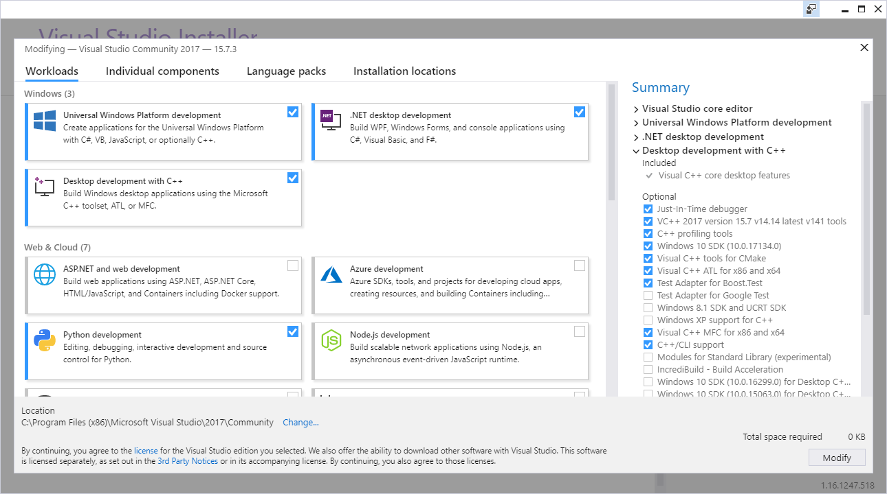

Slide 181
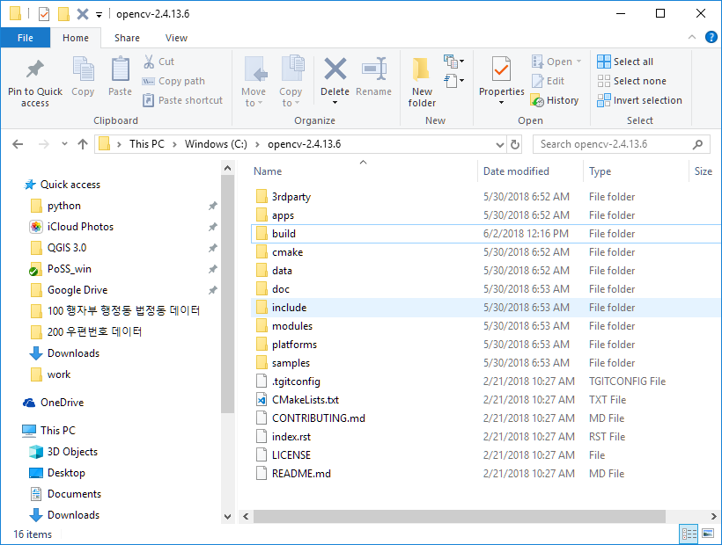

Slide 182
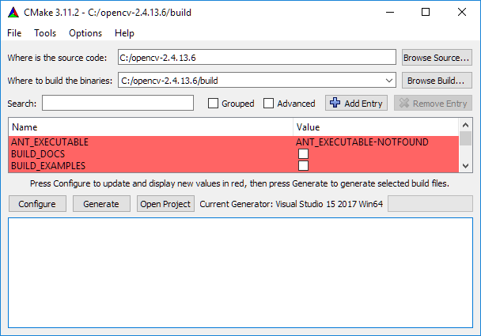
cmake-gui 실행
Configure
Generatre
Open project
Visual Studio Project 빌드

Slide 183
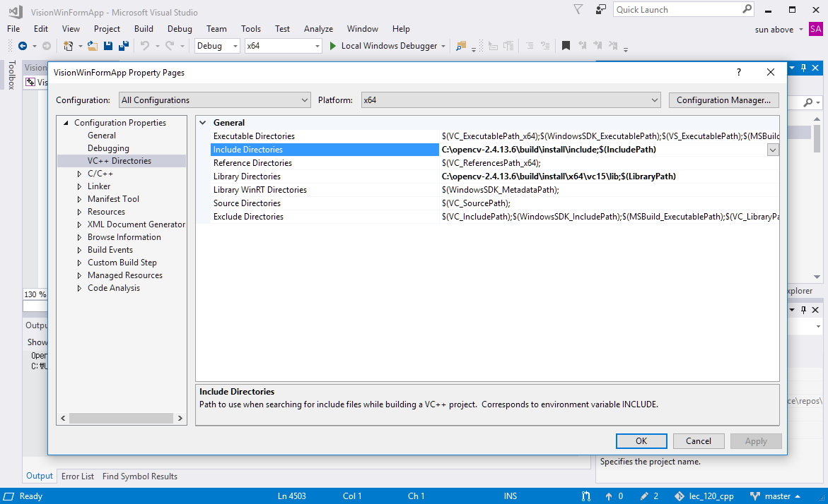
Windows Form Project 설정 ½
Include Directories 설정
Library Directories 설정

Slide 184
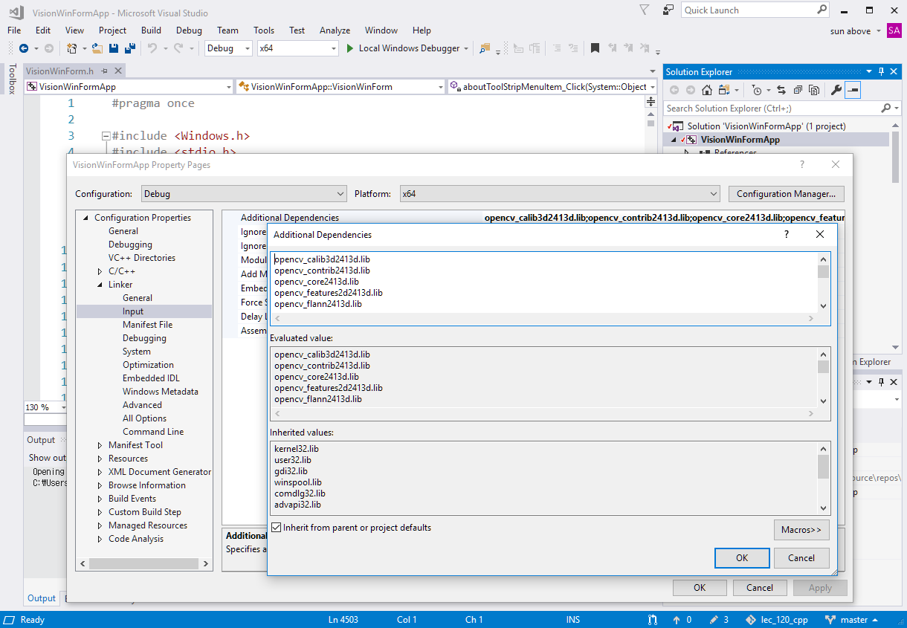
Windows Form Project 설정 2/2
Lib 설정

Slide 185
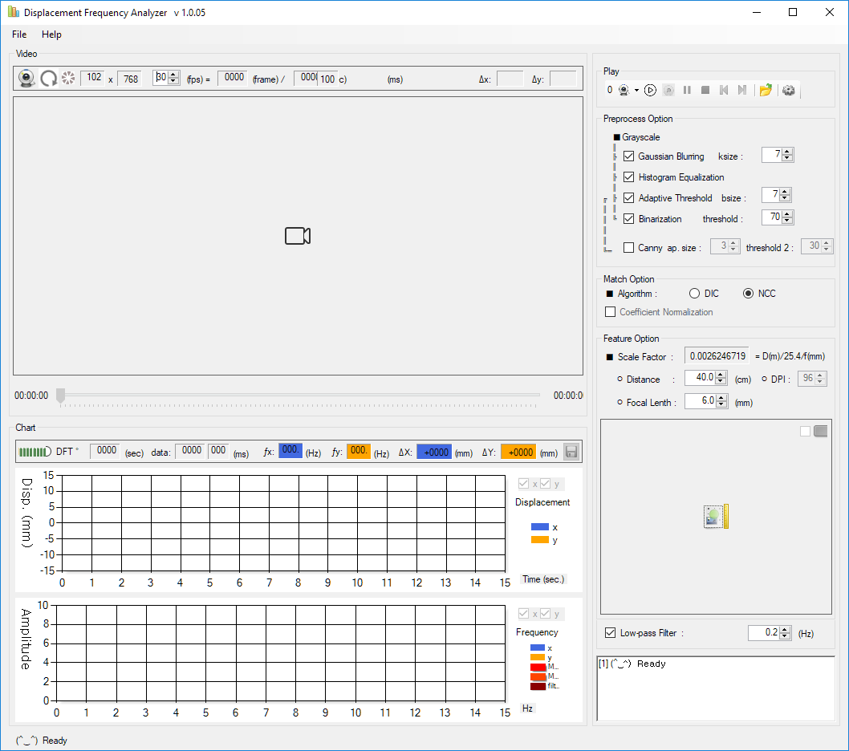
프로그램 실행

Slide 186
끝.

